Slide 1
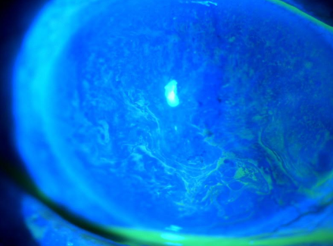
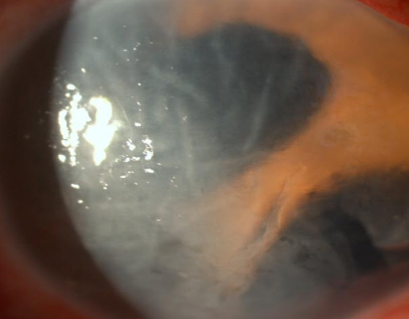
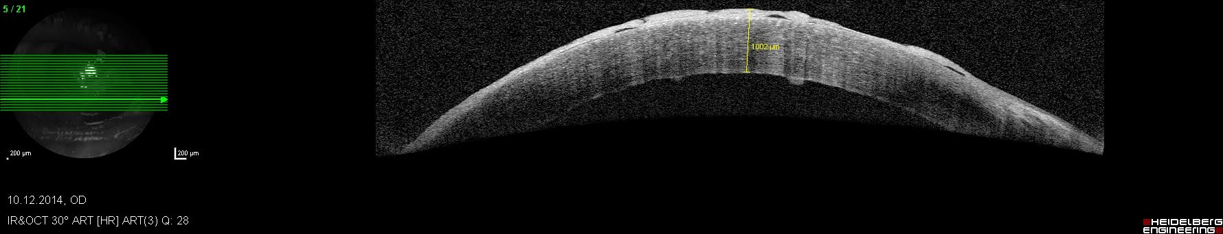
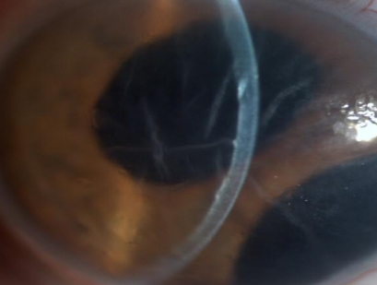
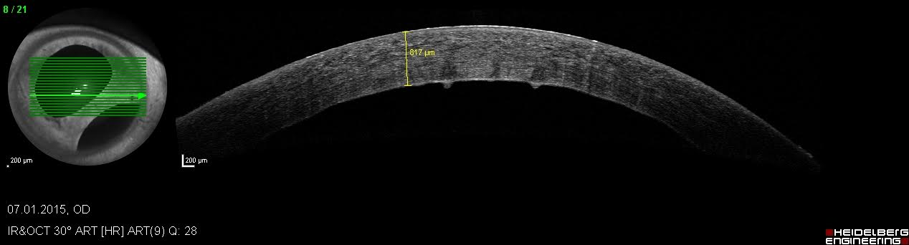
Improving Quality Of Life With Corneal Collagen Cross-linking In A Patient With Bullous Keratopathy A case report Azra Herceg, Vladimir Pfeifer and Mirna Štabuc Šilih Eye Hospital, University Medical Centre, Ljubljana, Slovenia
The authors declare no financial interest in this presentation

Slide 2

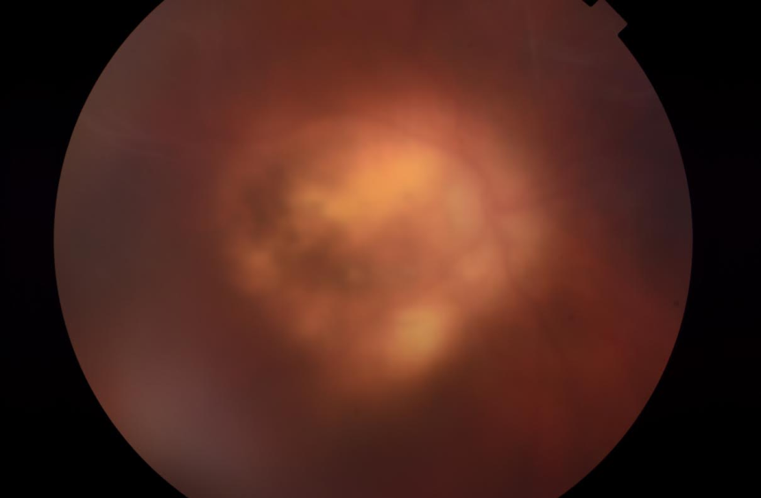
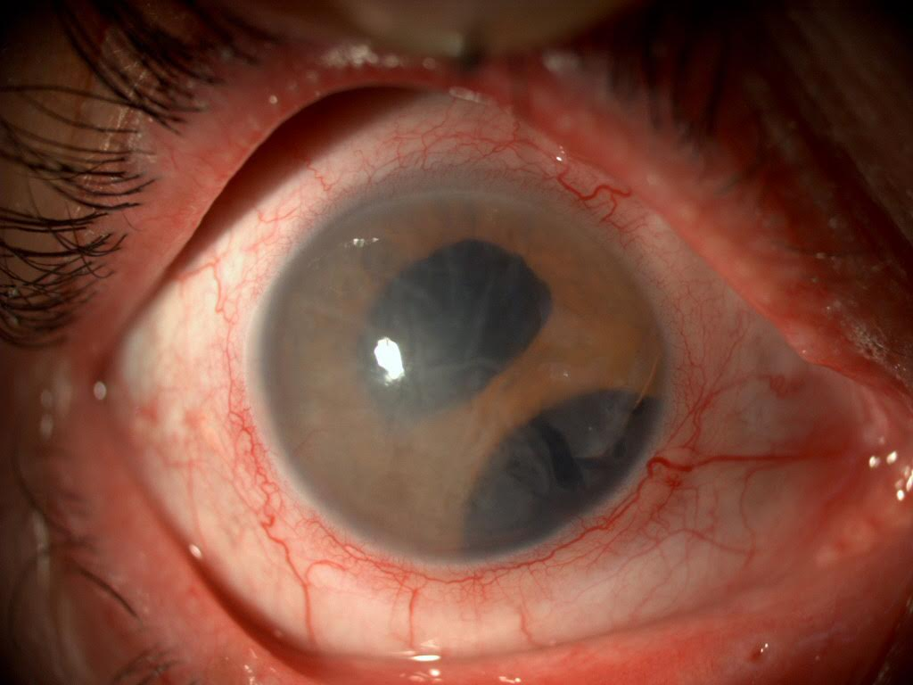
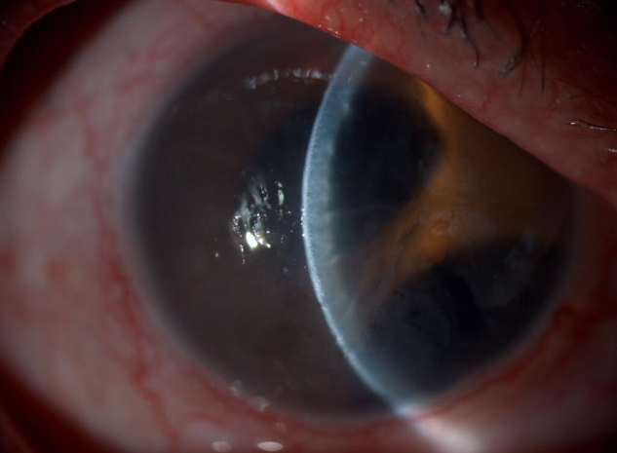
Setting
Right Eye before CXL: CCT 1000 µm, VAS 6
57 years old male patient seeking alternative solution to bandage contact lens since he refused to handle the lens by himself
Penetrating injury to the right eye 35 years ago
Vitrectomy in July 2014 due to lens luxation (bullous keratopathy already present before surgery)
Bullous keratopathy with recurrent corneal erosions → severely decreased quality of life
BCVA before and after surgery: hand movement
Not a candidate for corneal transplantation due to severe retinal atrophiy discovered during VR surgery

Slide 3
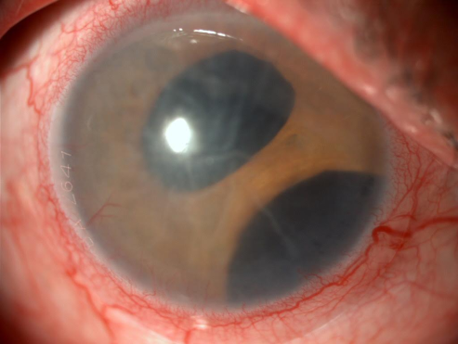
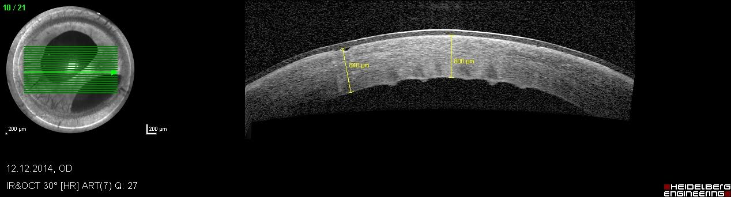

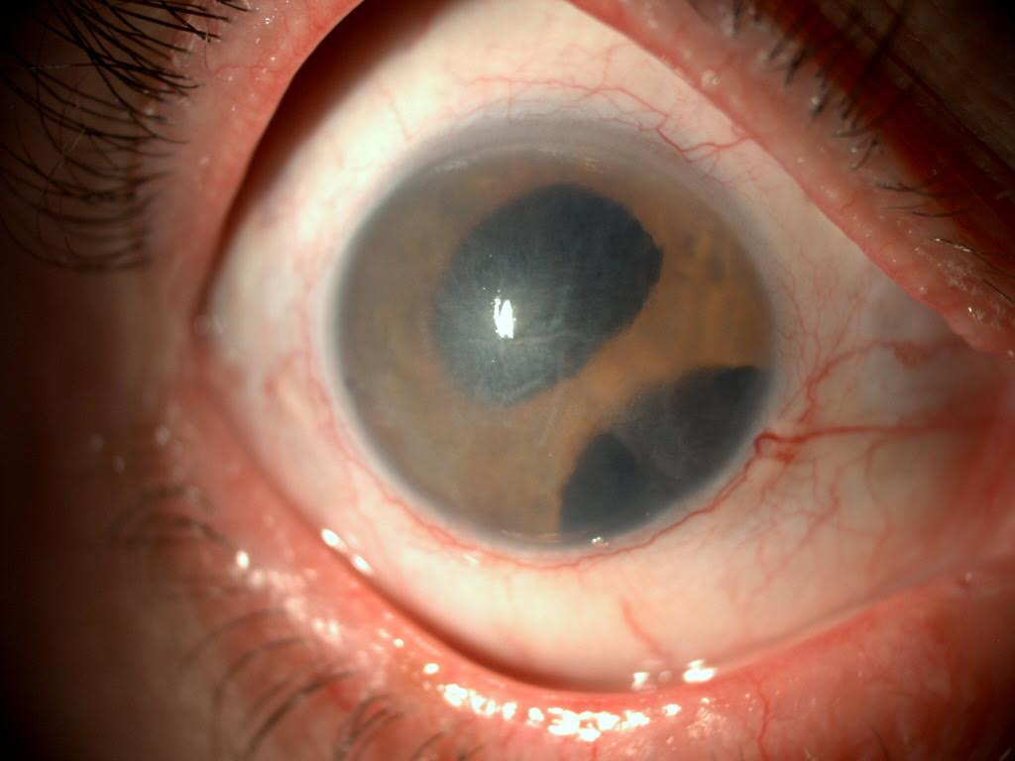
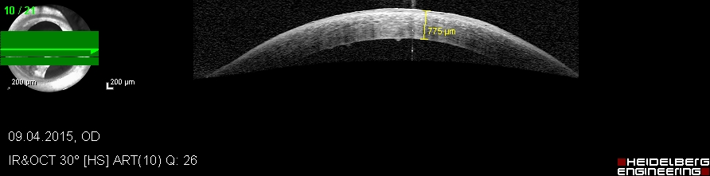
Method
1 day after CXL
Corneal collagen cross-linking: right eye in December 2014
Standard CXL therapy: UVA of irradiance 3 W/cm² to de-epithelialized surface of 0,1% riboflavin soaked cornea for 30 minutes
After the procedure we regularly followed the patient in our unit performing anterior segment OCT, photo documentation and assesed the pain score with VAS
1 month after CXL: CCT 817 µm, VAS 0
4 months after CXL: CCT 817 µm, VAS 0

Slide 4
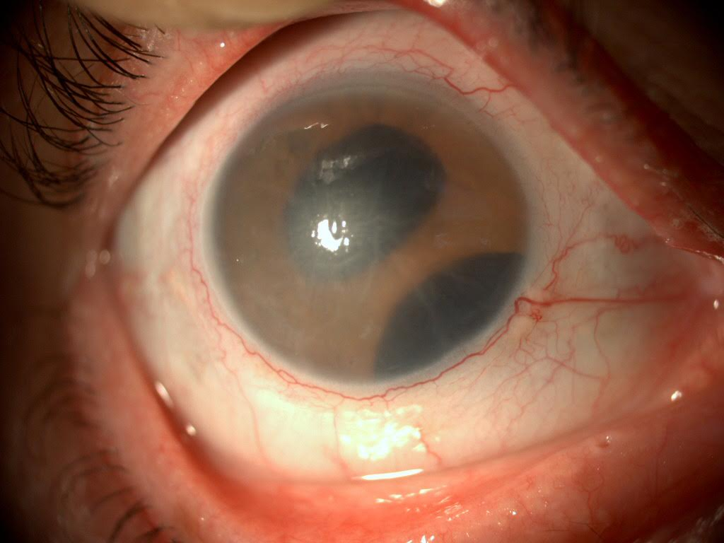
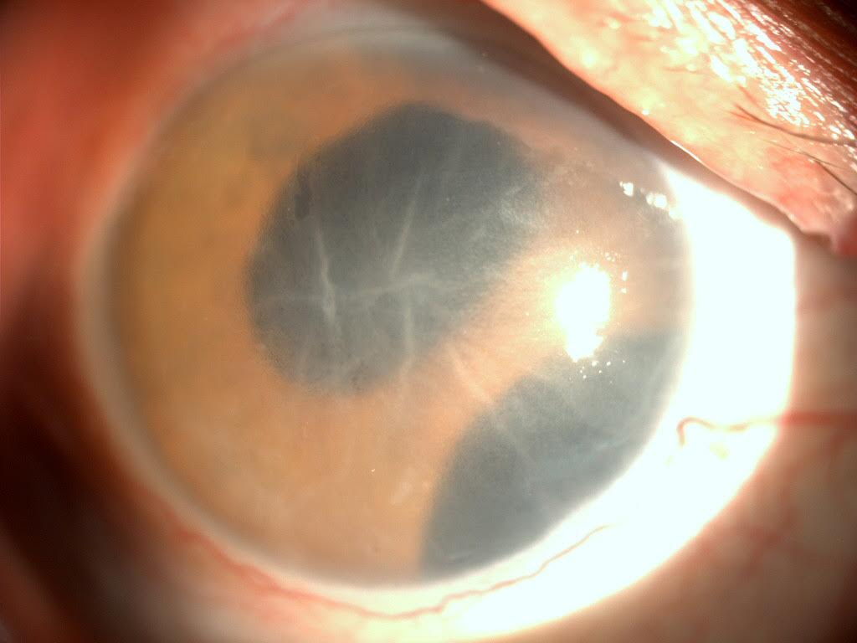
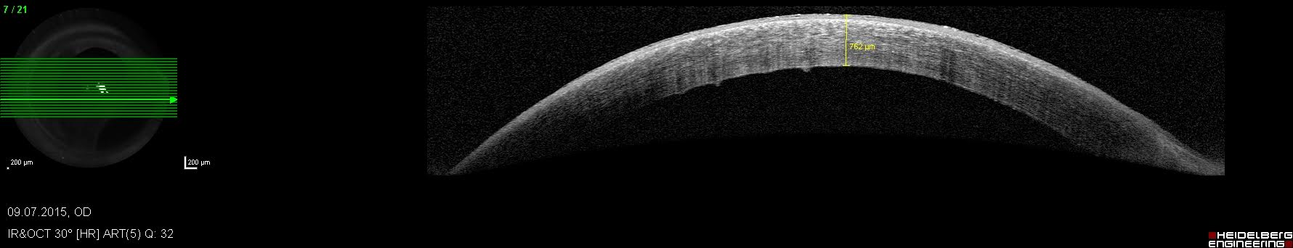
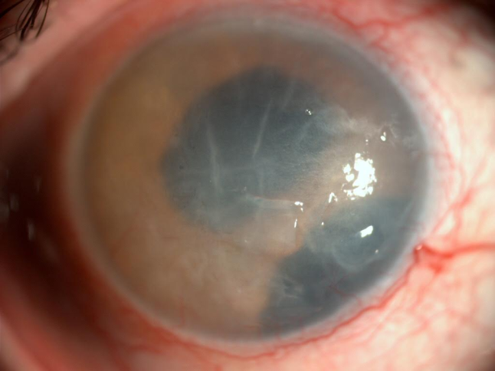
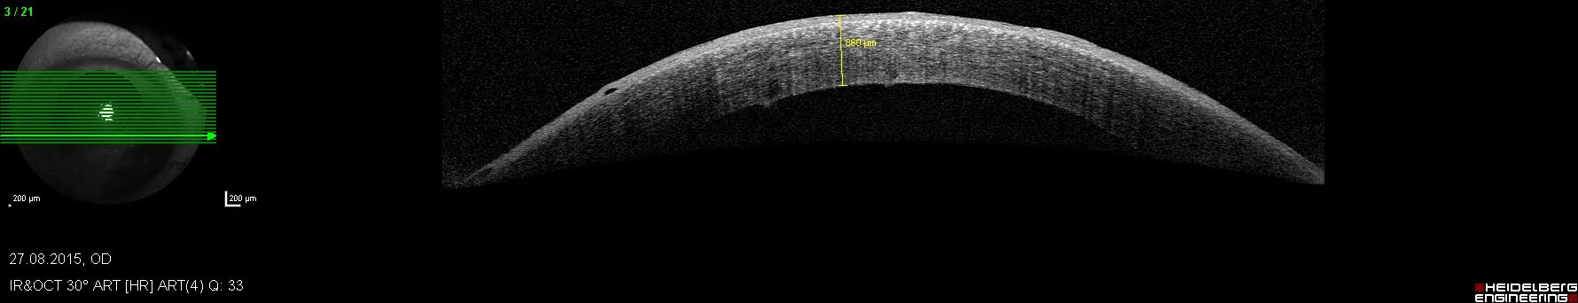
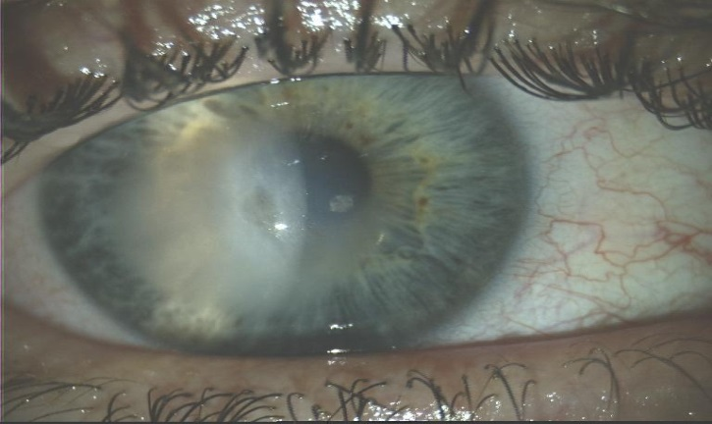
Results
6 months after CXL: CCT 762 µm, VAS 0
Patient reported alleviation of pain and tearing for almost 8 months (max at 1 month), symptoms reccured at 8 months post CXL following an episode of acute conjunctivitis
We noticed:
decrease of overall corneal haze (max at 1 month, reccurence after 6 months
slight decrease of edema (throughout follow-up period)
decrease and disappearance of bullous changes for 8 months with eventual reccurence
BCVA remains hand movement
Patient reported marked increase in quality of life lasting for almost 8 months while he was completely pain-free
8 months after CXL: CCT 860 µm, VAS 4-5, recurrence of bullous changes!!!

Slide 5
Discussion
According to available literature CXL with riboflavin 0,1% and UVA can strenghten interfiber attachments, reducing the potential space for fluid accumulation in edematous cornea -> Stromal compaction -> improvement in optical function after CXL?
In initial studies, CXL using the standard protocol has been shown to have a transient beneficial effect on vision, corneal thickness, clarity, and pain score.
Some authors found they could prolong the beneficial effect using different corneal dehydration techniques
Most authors report that the mean visual acuity, symptoms, and pachymetry readings improve significantly at 1 month postoperatively but slowly deteriorate between 3-6 months thereafter
We noticed decrease of overall corneal haze which lasted for ca 6 months (max at 1 m), decrease of pachymetry readings throughout the follow-up period (even after reccurence of symptoms and bullous changes at 8m) and our patient reports being pain-free for almost 8 months
Eventually the patient was offered keratoplasty as symptomatic treatment (vision prognosis remains poor due to retinal atrophy), but so far he refuses to undergo the procedure
Conclusions
We believe cross-linking is promising as an adjunctive treatment for symptomatic patients with bullous keratopathy especially in those who are awaiting keratoplasty
In accordance with available literature we conclude that the beneficial effect seems to be transient
However in our case it significantly increased patient's reported quality of life for 8 months
References:
G. Wollensak, H. Aurich, D.-T. Pham, and C. Wirbelauer, “Hydration behavior of porcine cornea crosslinked with riboflavin and ultraviolet A,” Journal of Cataract & Refractive Surgery, vol. 33, no. 3, pp. 516–521, 2007.
N. Ehlers and J. Hjortdal, “Riboflavin-ultraviolet light induced cross-linking in endothelial decompensation,” Acta Ophthalmologica, vol. 86, no. 5, pp. 549–551, 2008
G. Wollensak, H. Aurich, C. Wirbelauer, and D. T. Pham, “Potential use of riboflavin/UVA cross-linking in bullous keratopathy,” Ophthalmic Research, vol. 41, no. 2, pp. 114–117, 2009.
D. N. Gadelha, B. M. Cavalcanti, and V. Bravo Filho, “Therapeutic effect of corneal collagen crosslinking on symptomatic bullous keratopathy,” Arquivos Brasileiros de Oftalmologia, vol. 72, no. 4, pp. 462–466, 2009 (Portuguese).
M. M. Cordeiro Barbosa, J. B. Barbosa Jr., F. E. Hirai, and A. L. Hofling-Lima, “Effect of cross-linking on corneal thickness in patients with corneal edema,” Cornea, vol. 29, no. 6, pp. 613–617, 2010.
R. C. Ghanem, M. R. Santhiago, T. B. Berti, S. Thomaz, and M. V. Netto, “Collagen crosslinking with riboflavin and ultraviolet-A in eyes with pseudophakic bullous keratopathy,” Journal of Cataract and Refractive Surgery, vol. 36, no. 2, pp. 273–276, 2010. View at Publisher ·
F. Hafezi, P. Dejica, and F. Majo, “Modified corneal collagen crosslinking reduces corneal oedema and diurnal visual fluctuations in Fuchs dystrophy,” British Journal of Ophthalmology, vol. 94, no. 5, pp. 660–661, 2010.
R. Arora, A. Manudhane, R. K. Saran, J. Goyal, G. Goyal, and D. Gupta, “Role of corneal collagen cross-linking in pseudophakic bullous keratopathy,” Ophthalmology, vol. 120, no. 12, pp. 2413–2418, 2013.
N. Sharma, S. Roy, P. K. Maharana et al., “Outcomes of corneal collagen crosslinking in pseudophakic bullous keratopathy,” Cornea, vol. 33, no. 3, pp. 243–246, 2014.

